Slide 1

FINAL PRESENTATION The Clehuderfax E-Chain
Team Title: The Influencers
Group:5
Project Manager: Mr. Rohit Pandey

Slide 2

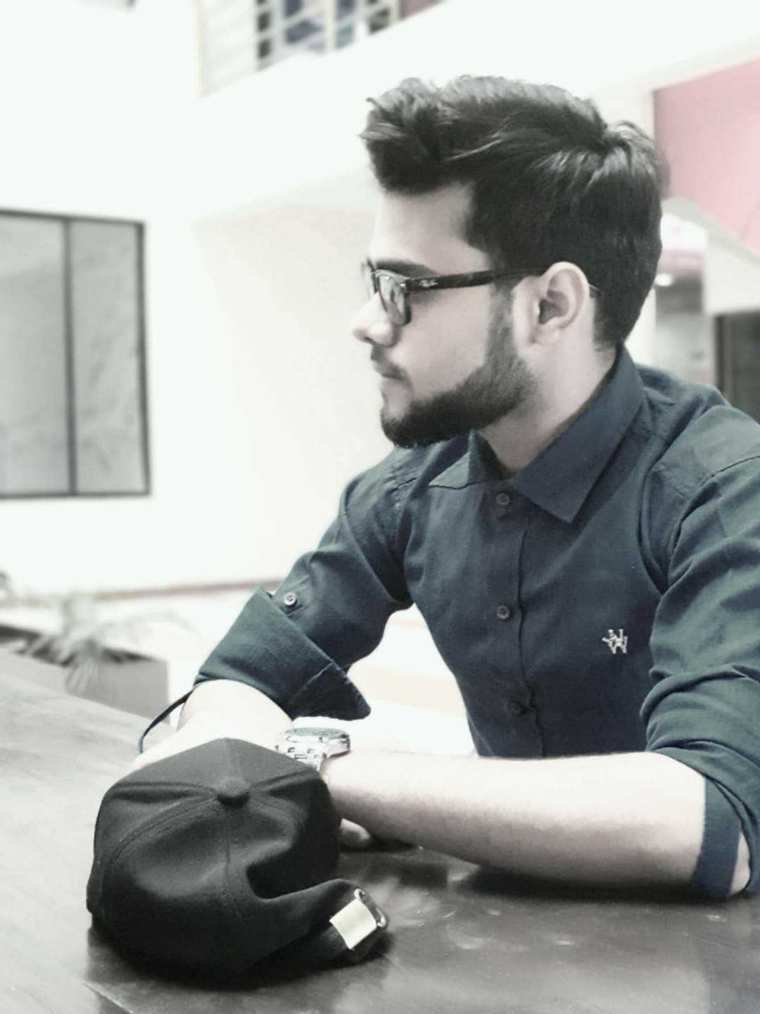

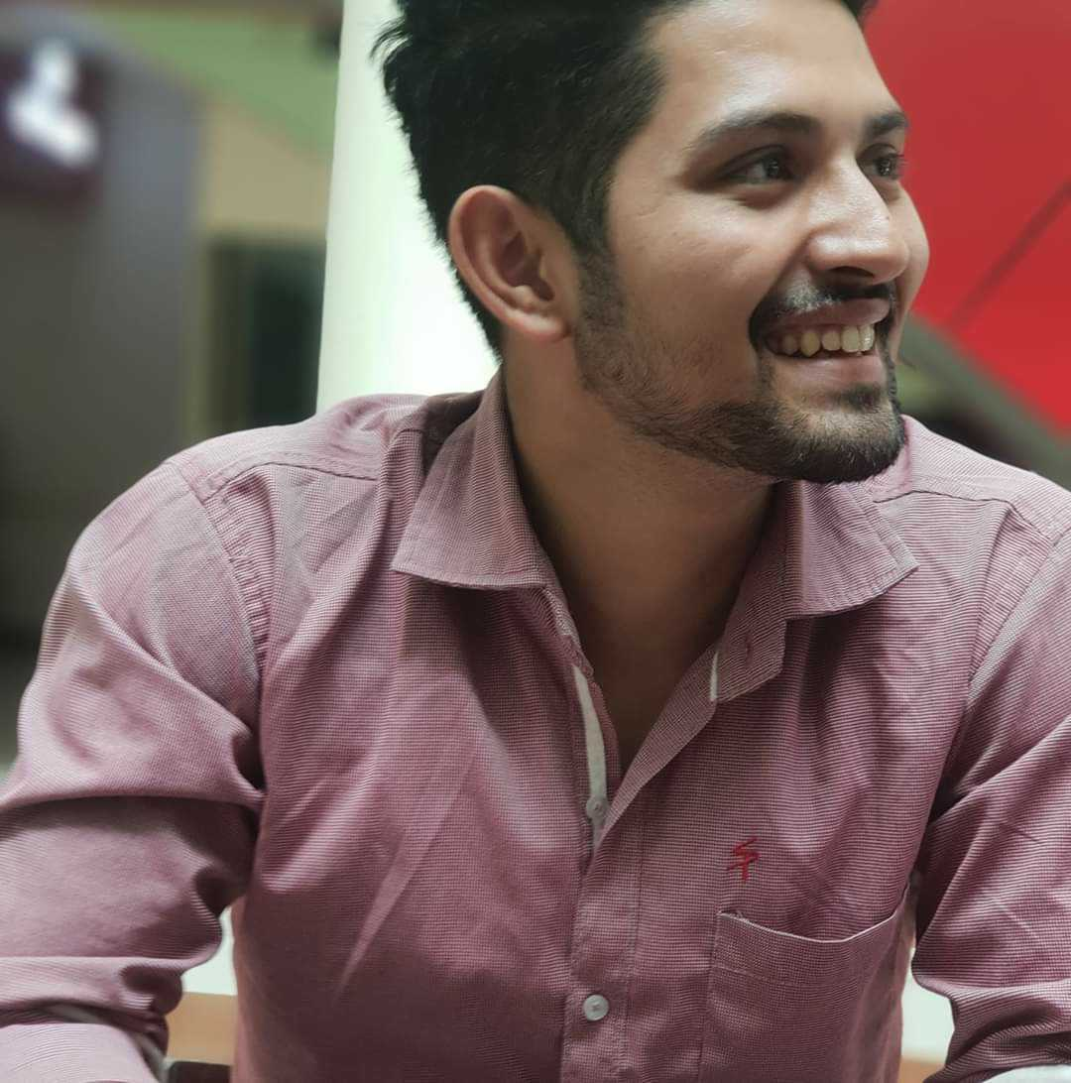

Sponsored By: THE BRITISH COLLEGE
Team Members:
Bijay Giri
Dipesh BC
Kadamber Verma
Rajbir Chand
Sushant Tiwari

Slide 3
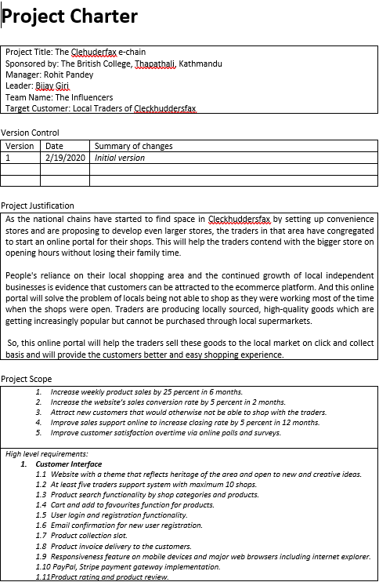
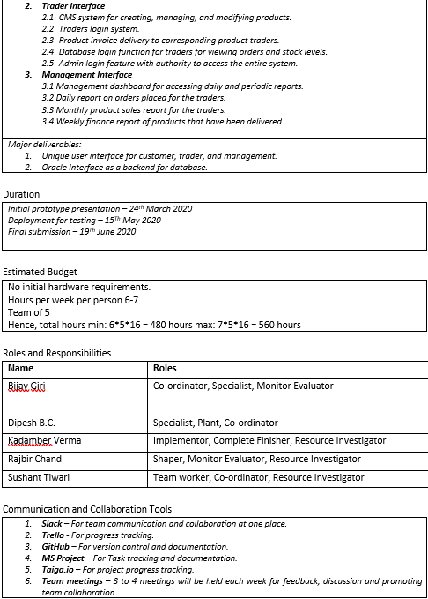
PROJECT CHARTER

Slide 4
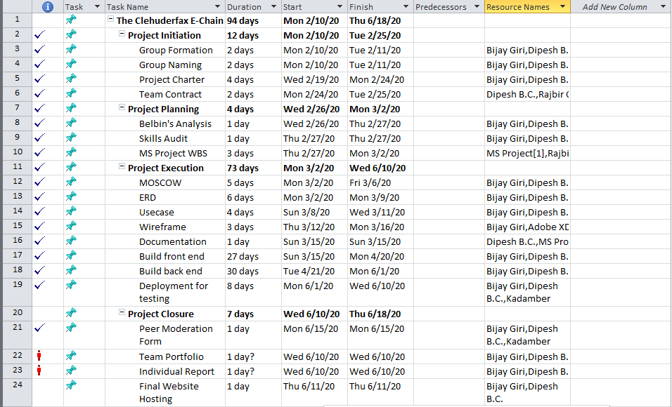
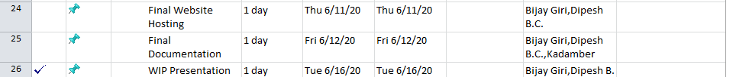
TASK SHEET

Slide 5
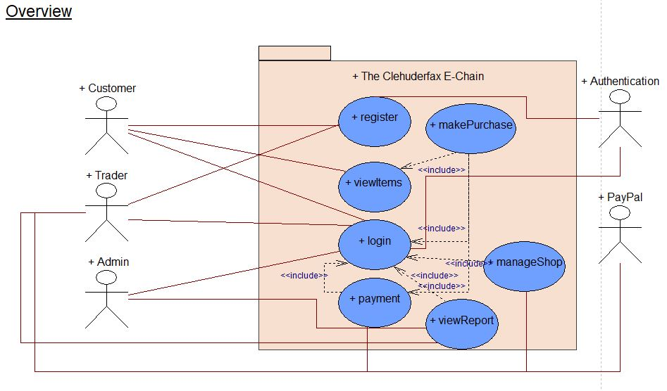
USE CASE OVERVIEW

Slide 6
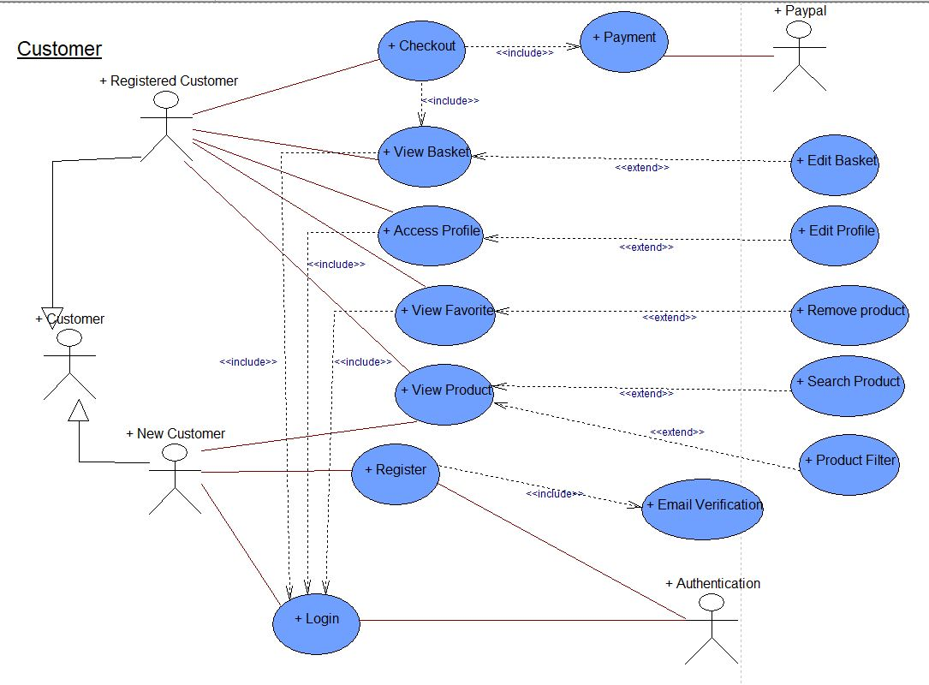
USE CASE CUSTOMER

Slide 7
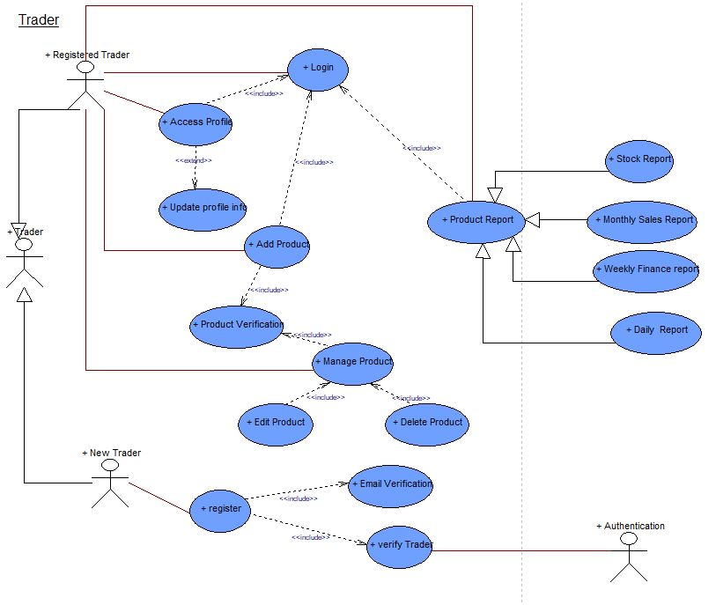
USE CASE TRADER

Slide 8
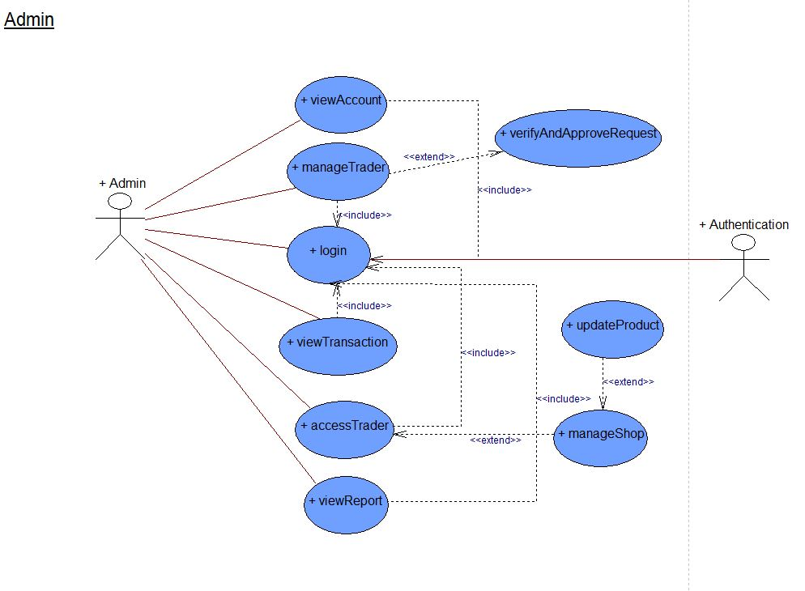
USE CASE ADMIN

Slide 9
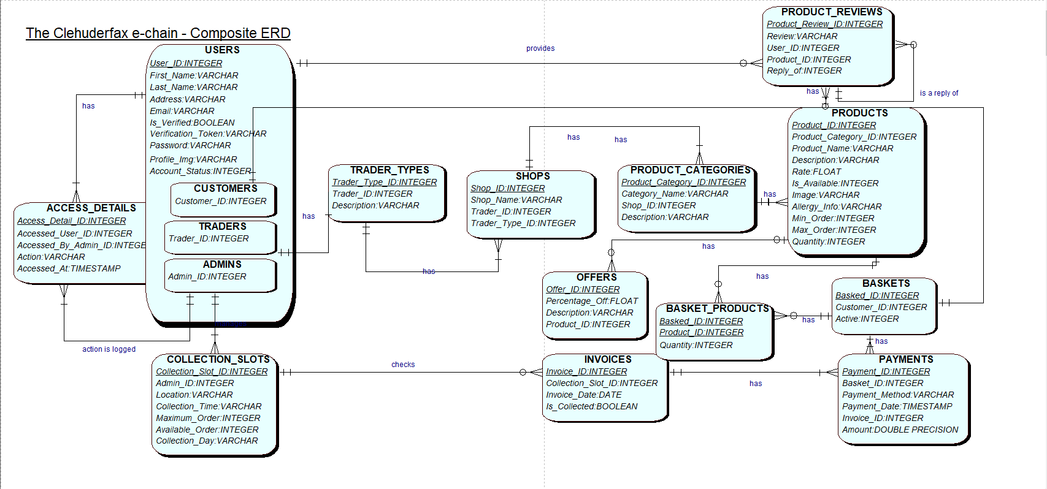
Composite diagram

Slide 10
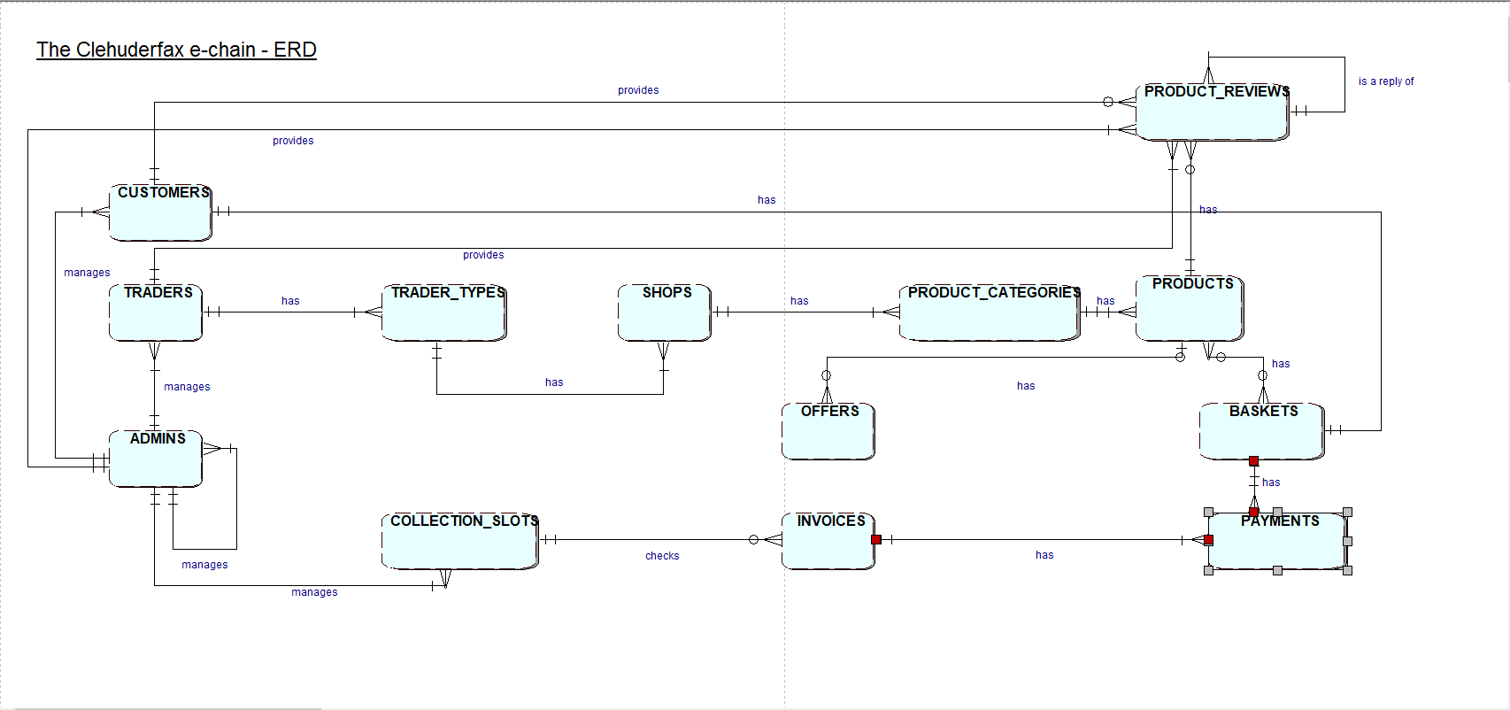
Entity Relationship Diagram

Slide 11
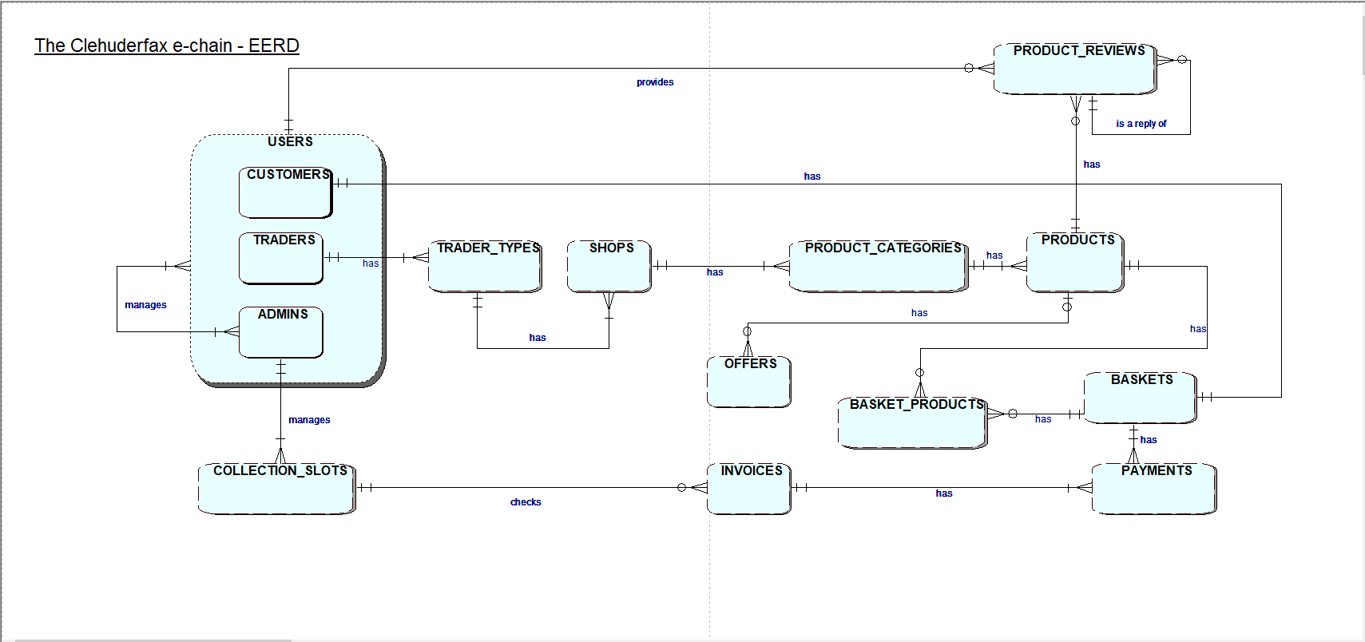
Enhanced Entity Relationship Diagram

Slide 12
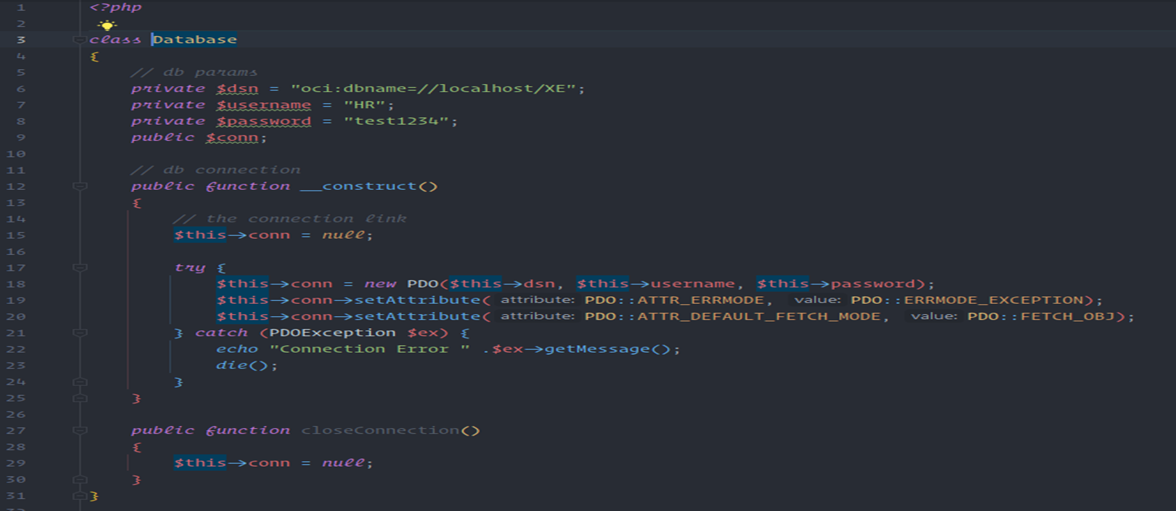
PHP and Oracle connection

Slide 13

WEBSITE DEMONSTRATION……!

